Slide 1
URL Shortener with Docker
A Complete Walkthrough
SURONJIT SHARMA
Dept. of CSE • SUST

Slide 2
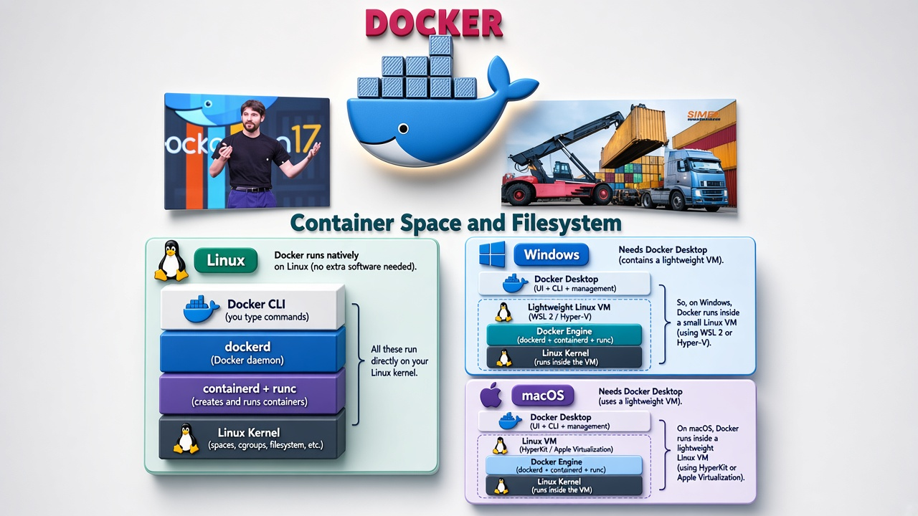
1. Docker – Container Space & Filesystem

Slide 3
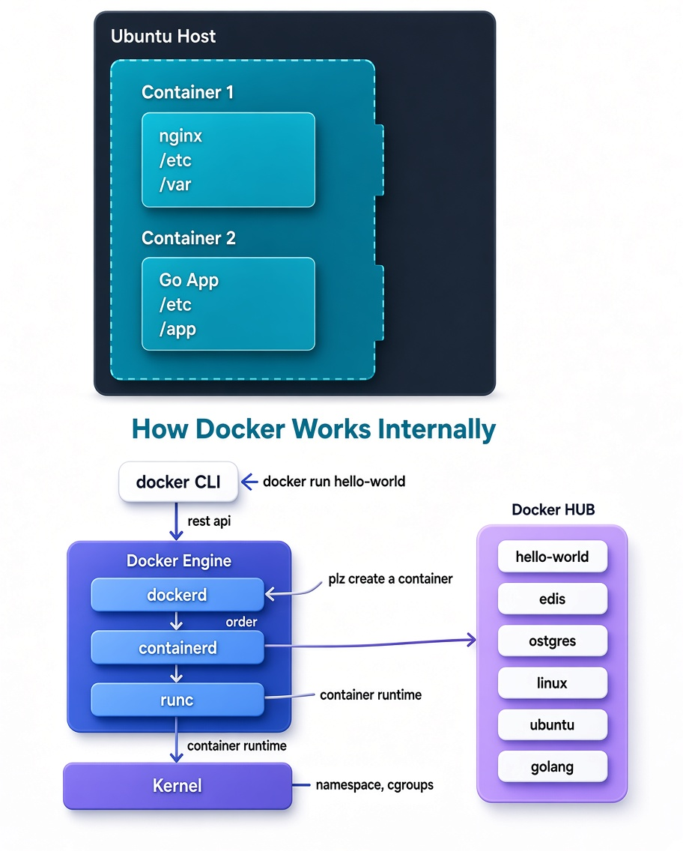
2. How Docker Works Internally

Slide 4
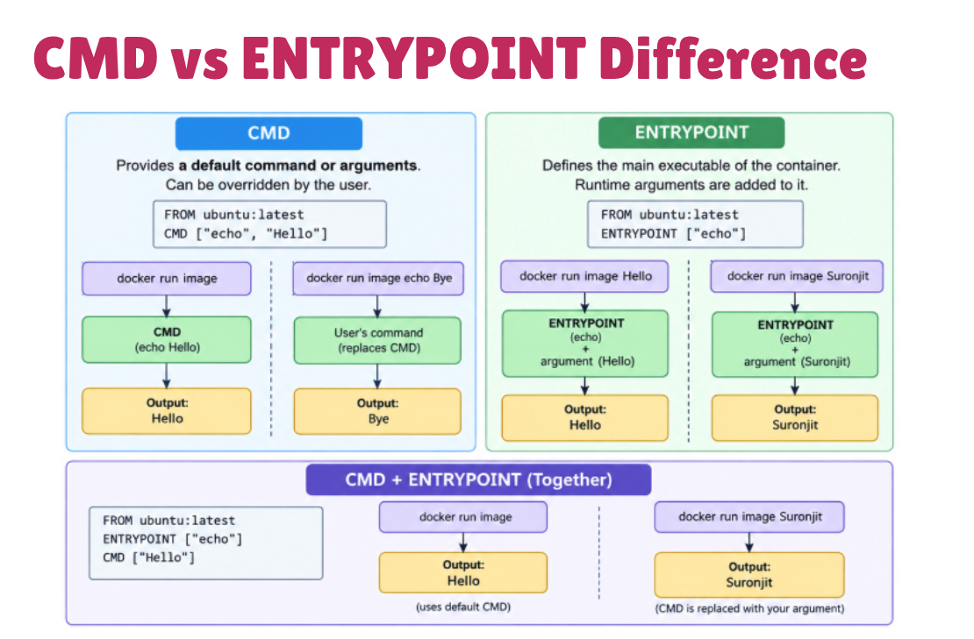
3. CMD vs ENTRYPOINT

Slide 5
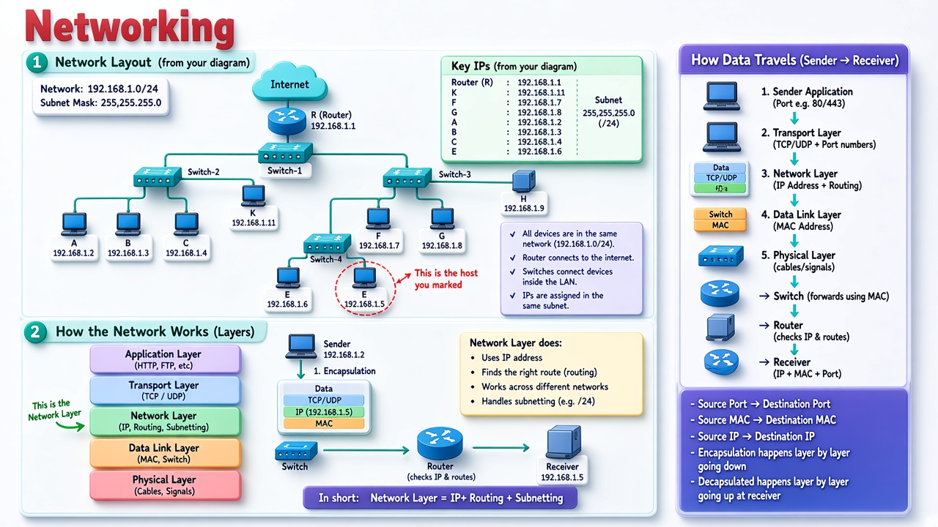
4. Networking

Slide 6
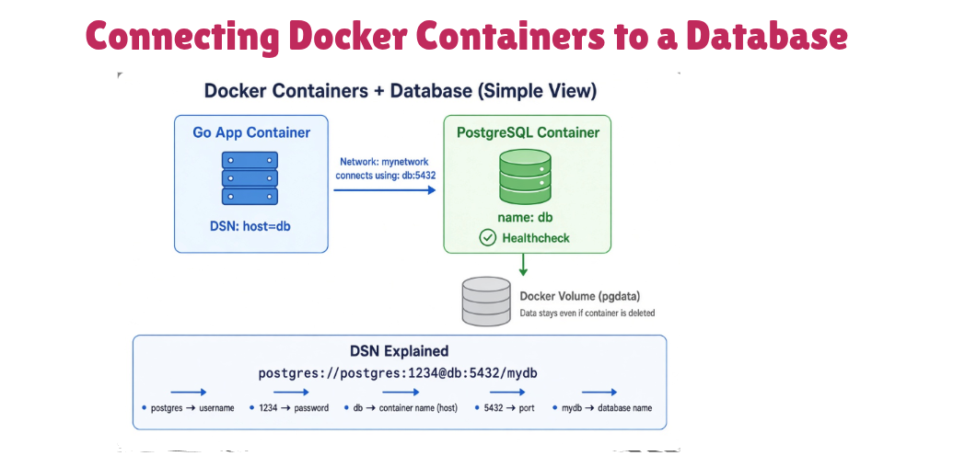
5. Connecting Containers to a Database

Slide 7
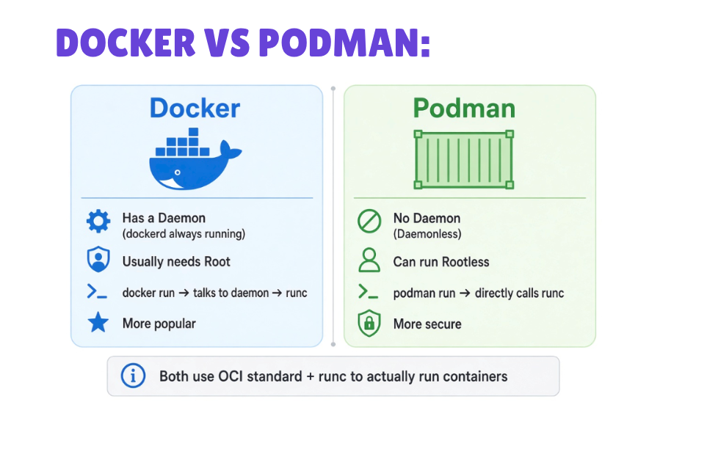
6. Docker vs Podman

Slide 8
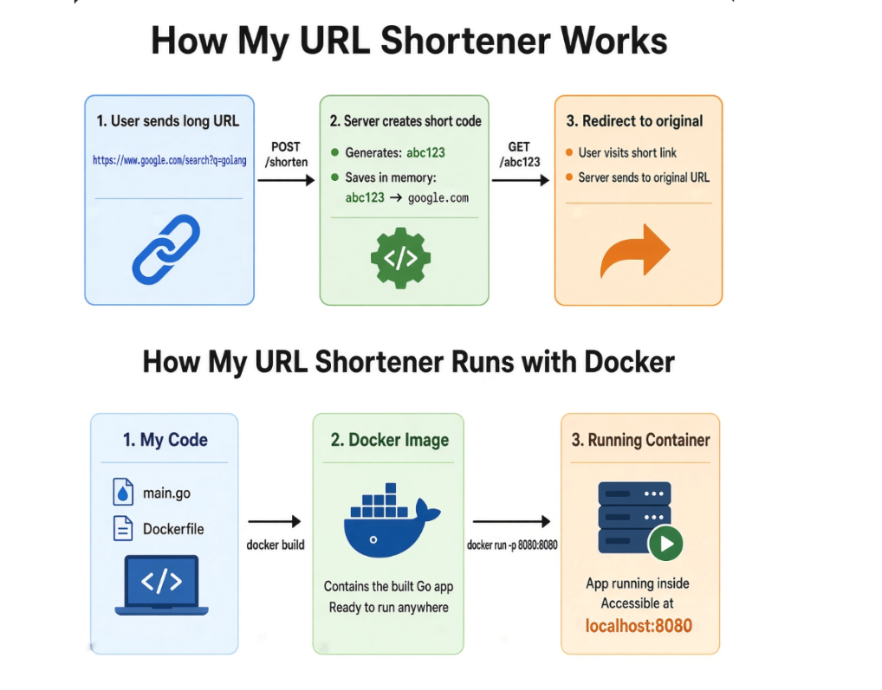
7. How My URL Shortener Works

Slide 9
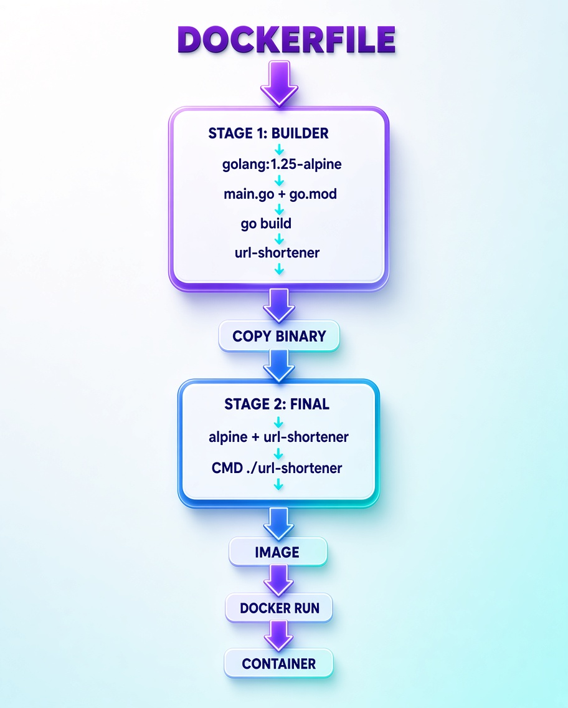
8. Dockerfile Multi-stage Flow

Slide 10
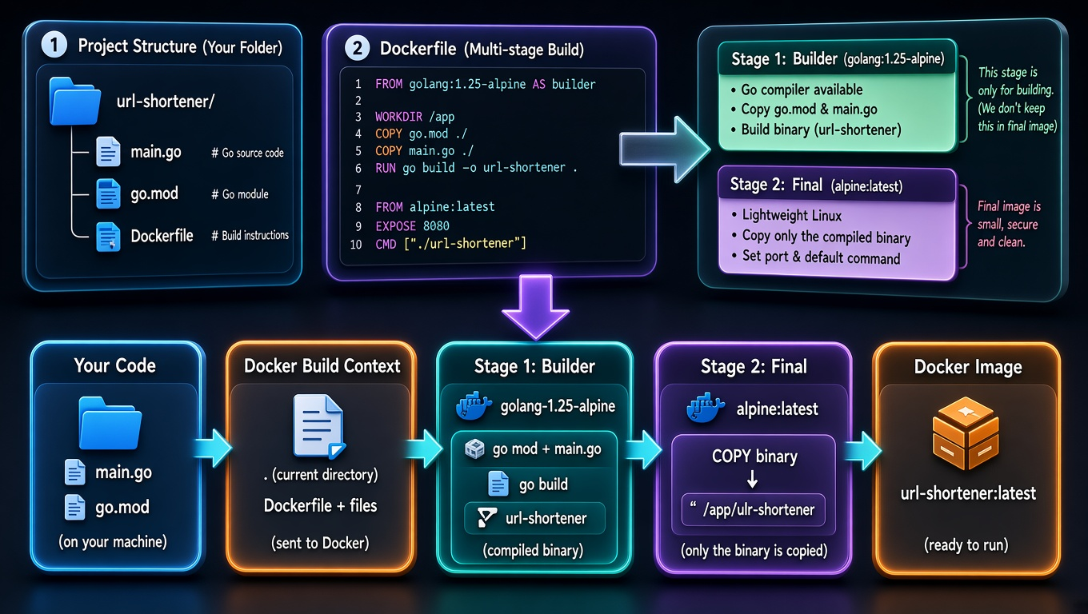
9. Project Structure & Multi-stage Build

Slide 11
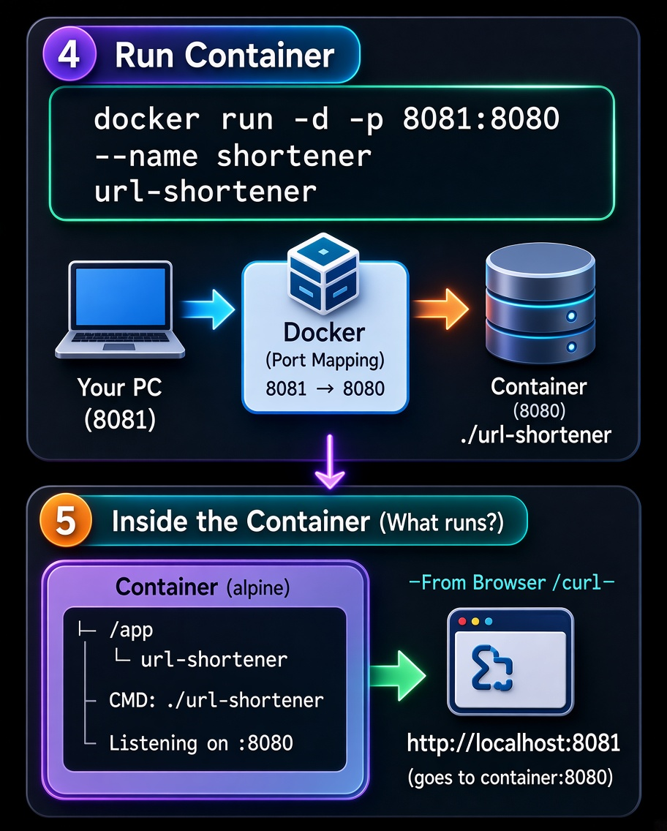
10. Run Container & Inside the Container

Slide 12
Thank You
Questions?
SURONJIT SHARMA | Dept. of CSE, SUST

